Slide 1

Code Refactoring and Bug Fixing

Slide 2
Scenario:
A team of enthusiastic data scientists embarked on a mission to develop a Note Taking Application using Python, Flask, and HTML. However, their lack of experience in backend development has led to challenges in making the application fully functional. Recognizing your proficiency in backend development, you have been tasked with fixing the broken code and ensuring the application works seamlessly.
Task:
Refactor the existing codebase and ensure the proper functioning of the Note Taking Application. Document all identified bugs during the debugging process. Remember, the task is not about recreating the app from scratch. Your goal is to fix the already existing codebase and make the application work as intended.

Slide 3
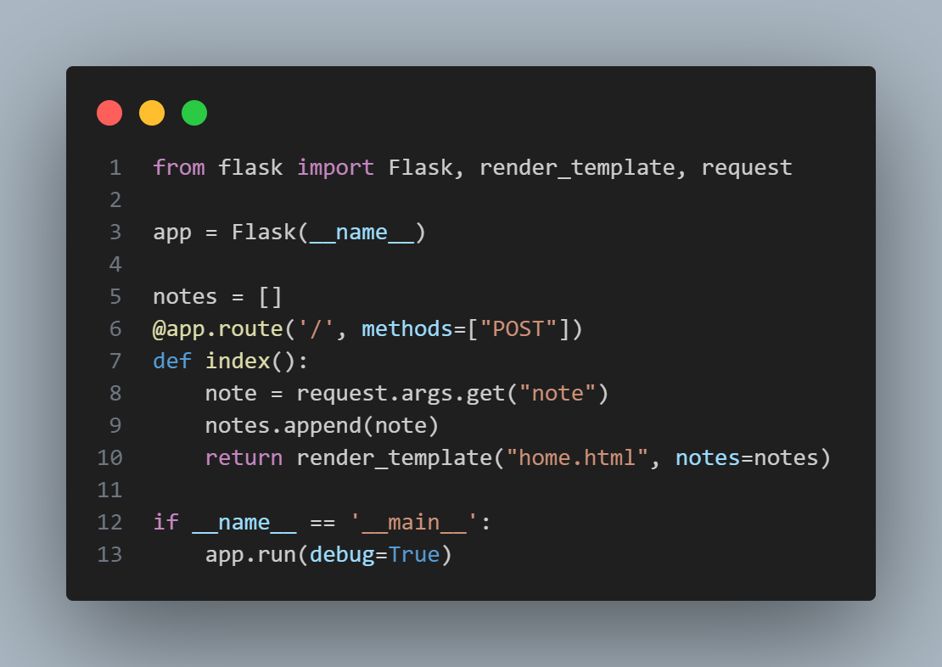
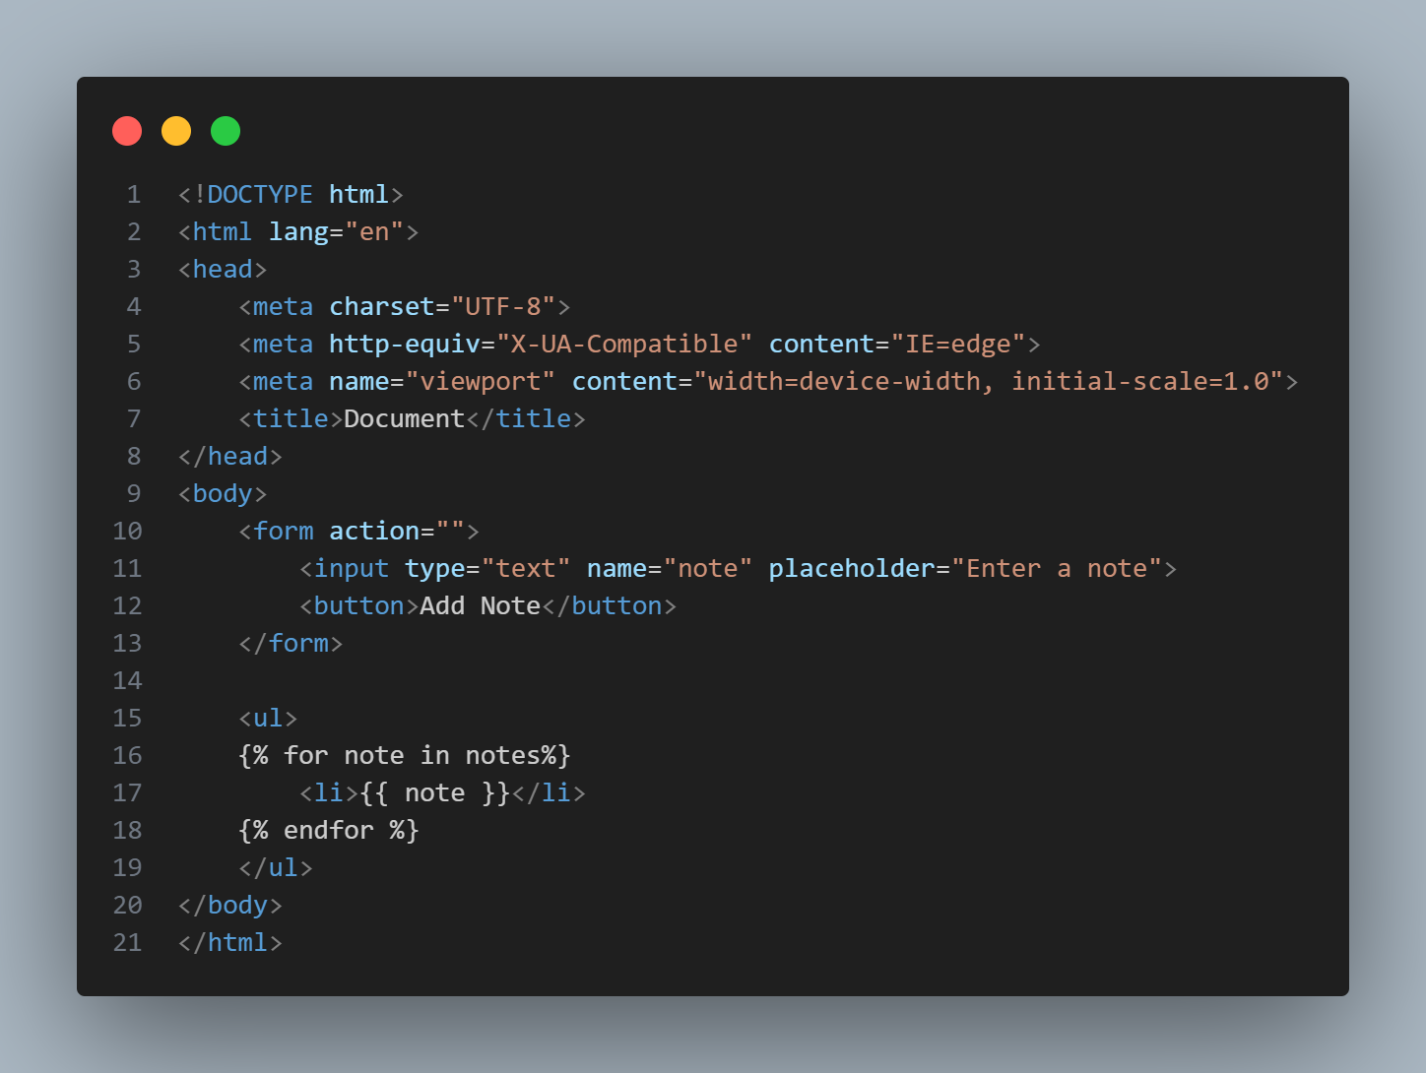
INITIAL CODE SNIPPET:
FLASK CODE:
HTML CODE:

Slide 4
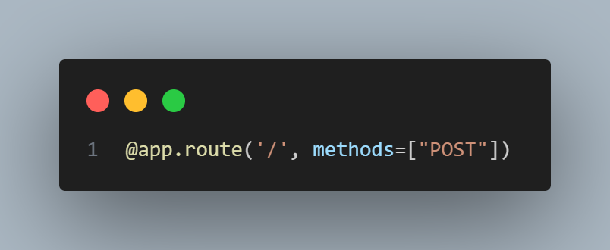
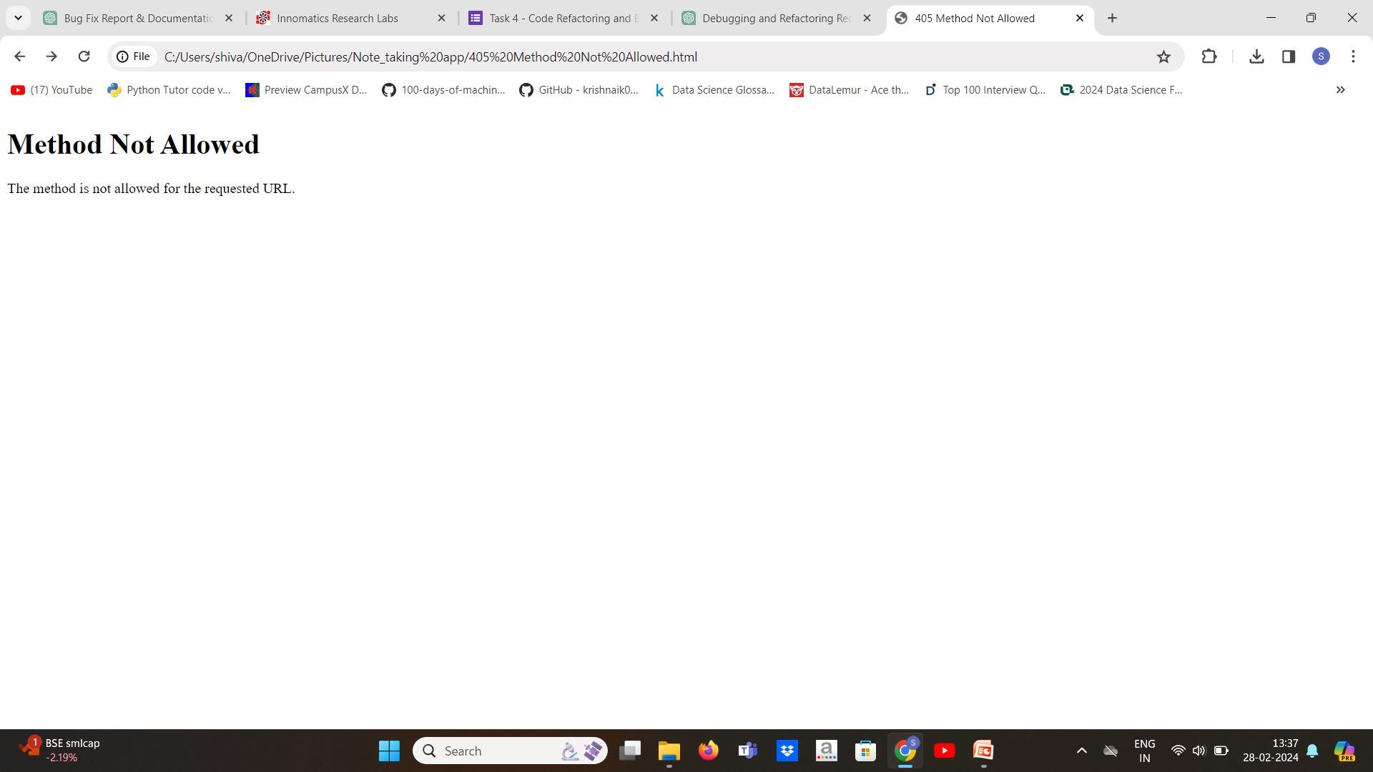
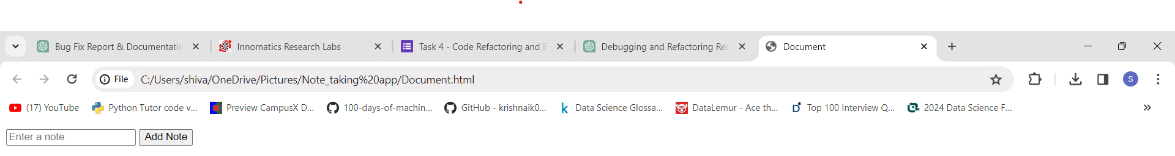
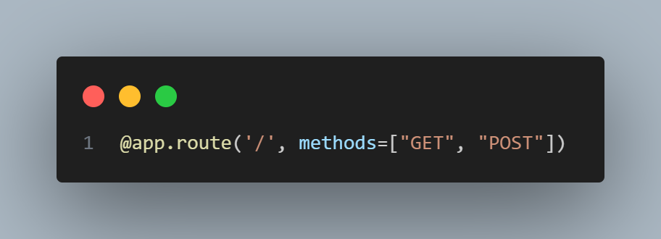
Bug 1:Incorrect HTTP Methods Handling
The home route was only configured to handle POST requests, resulting in GET requests being ignored.
OUTPUT:
Solution:
Output:
Solution:
Updated the route definition to handle both GET and POST requests.

Slide 5
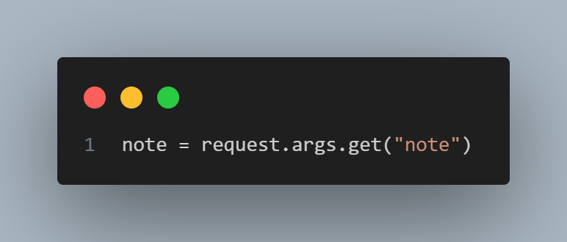
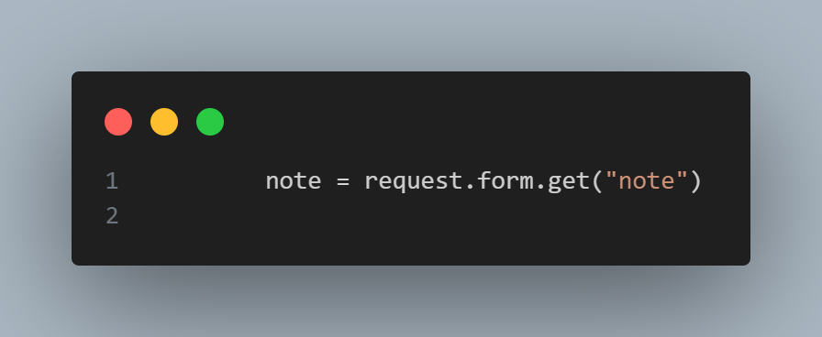
Bug 2: Incorrect Retrieval of Note Data The code was attempting to retrieve note data using the request.args method, which is suitable for GET requests but not POST requests.
Updated the code to retrieve note data using the request.form method, suitable for POST requests

Slide 6
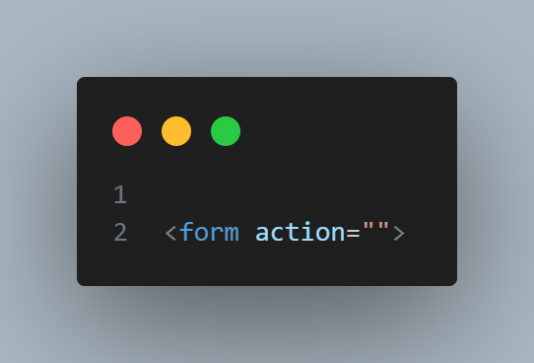

Bug 3: Missing Form Submission Method Description:
The HTML form element was missing the method attribute, which defaults to GET. This resulted in the form data not being submitted correctly.
Solution: Added the method="post" attribute to the form element to ensure data is submitted via POST requests.

Slide 7
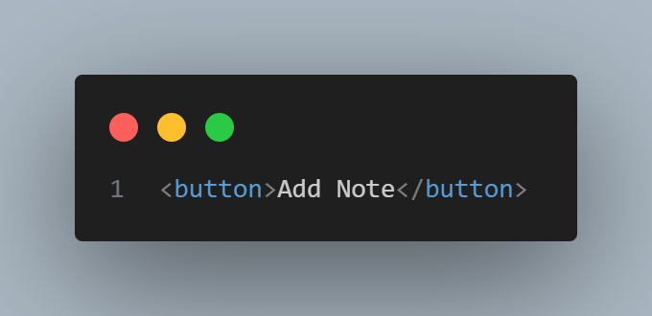
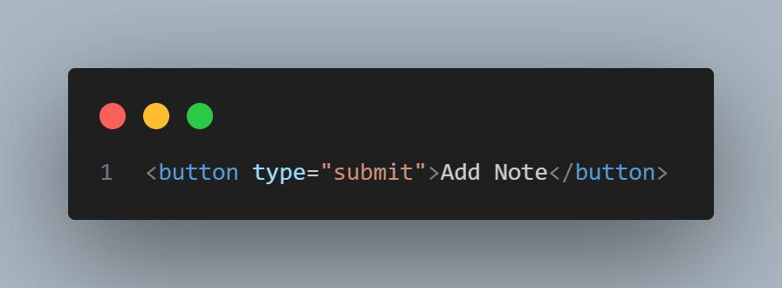
Bug 4: Missing Button Type :
The submit button within the form was missing the type attribute, which caused it to behave inconsistently across different browsers.
Solution:
Added the type="submit" attribute to the button element to specify its behavior as a form submission trigger.

Slide 8
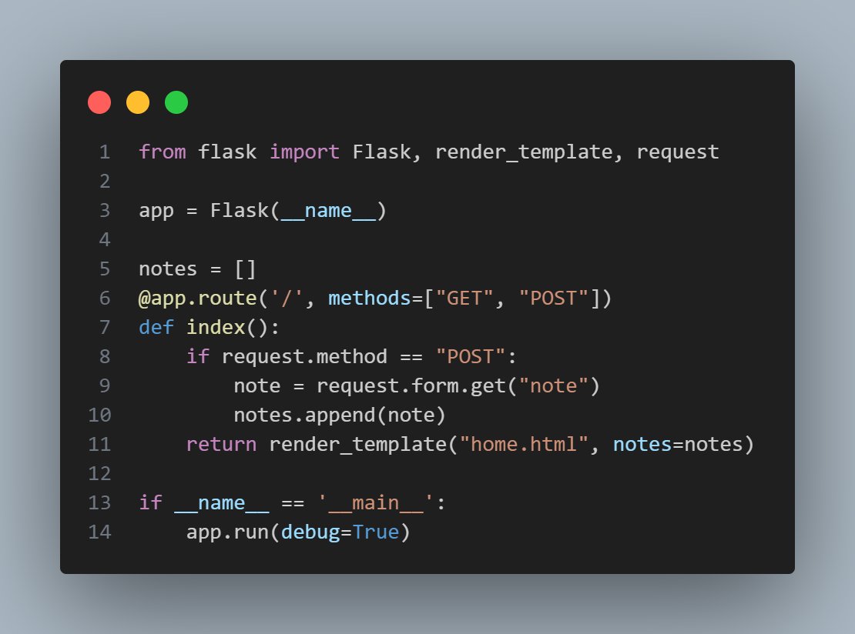
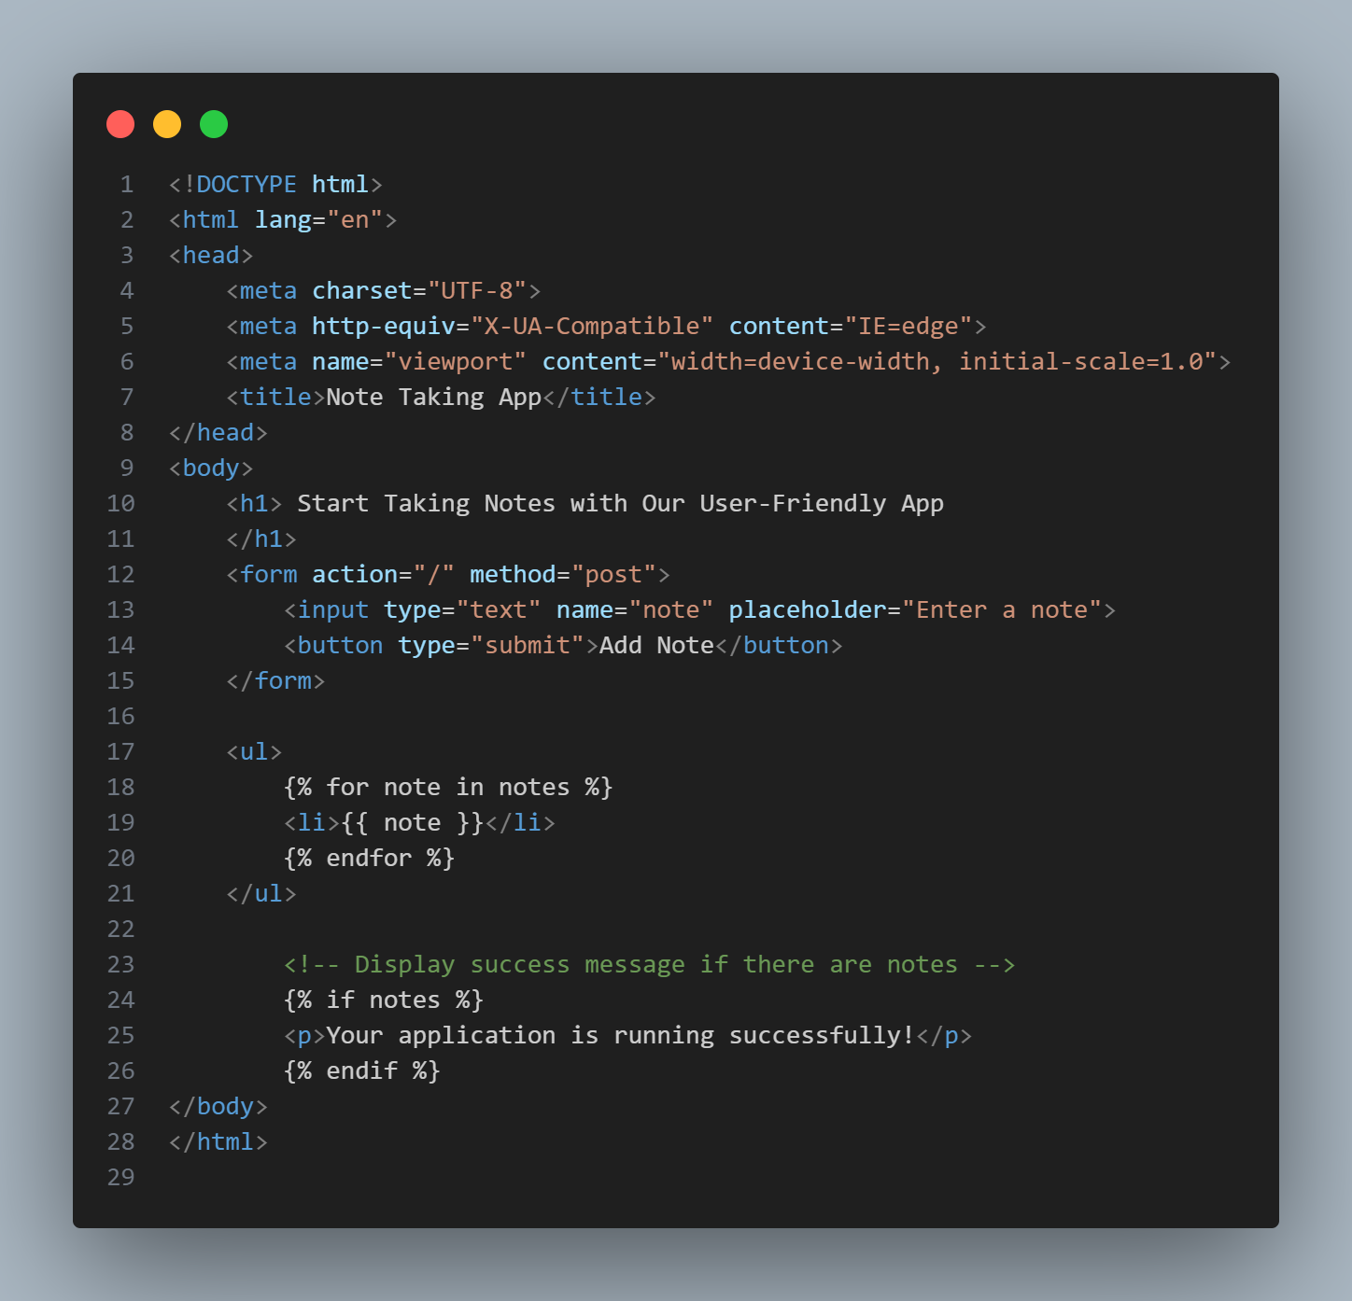
Final code after Debugging:

Slide 9
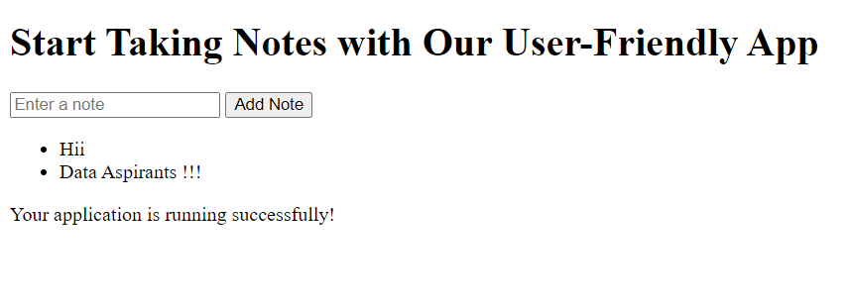
Conclusion:
Identified Bugs: We found several problems in the code, like issues with how the app handles user input and displays notes.
Solutions: We fixed these bugs by updating the code to handle user actions correctly, like adding new notes and showing them on the page.
Reliability and Functionality: By testing and debugging our code, we can ensure that our software works well and meets users' needs. This is crucial for making reliable and functional applications that people enjoy using.

Slide 10

THANK YOU

